Slide 1
My Portfolio

Slide 2
Design process…

Slide 3
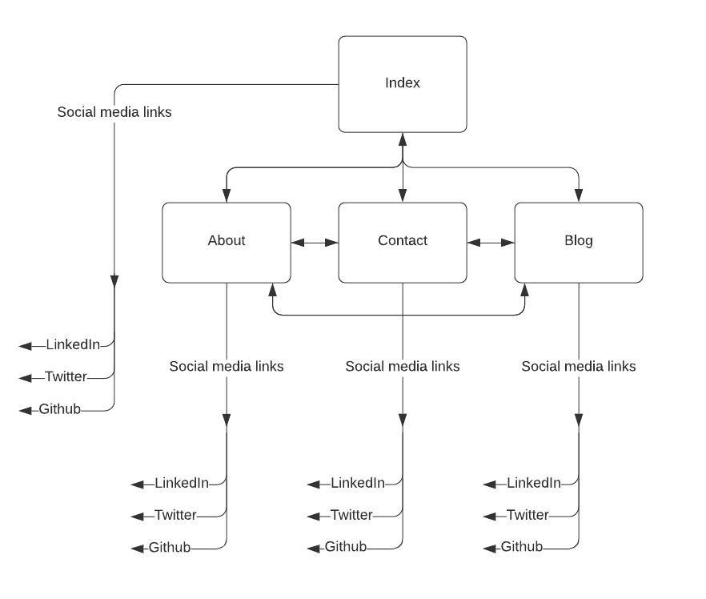
Sitemap
Links to social media pages in footers
Nav bar on each page to link to all other pages
Web has option to navigate to individual posts on the blog page via drop down list in nav bar.
Notes:
Walkthrough site navigation

Slide 4
Mobile wireframes:
Notes:
Walkthrough design process.
Wanted: not visually overwhelming, easy to navigate, grid/square layout, cohesive, showcase skills without being overwhelming.

Slide 5
Mobile wireframes
Simple, repeated frame to keep pages cohesive
Square themes
Side nav bar for thumb/touch screen navigation
Footer, titles and nav in same places for ease of navigation
Consistent up/down scrolling

Slide 6
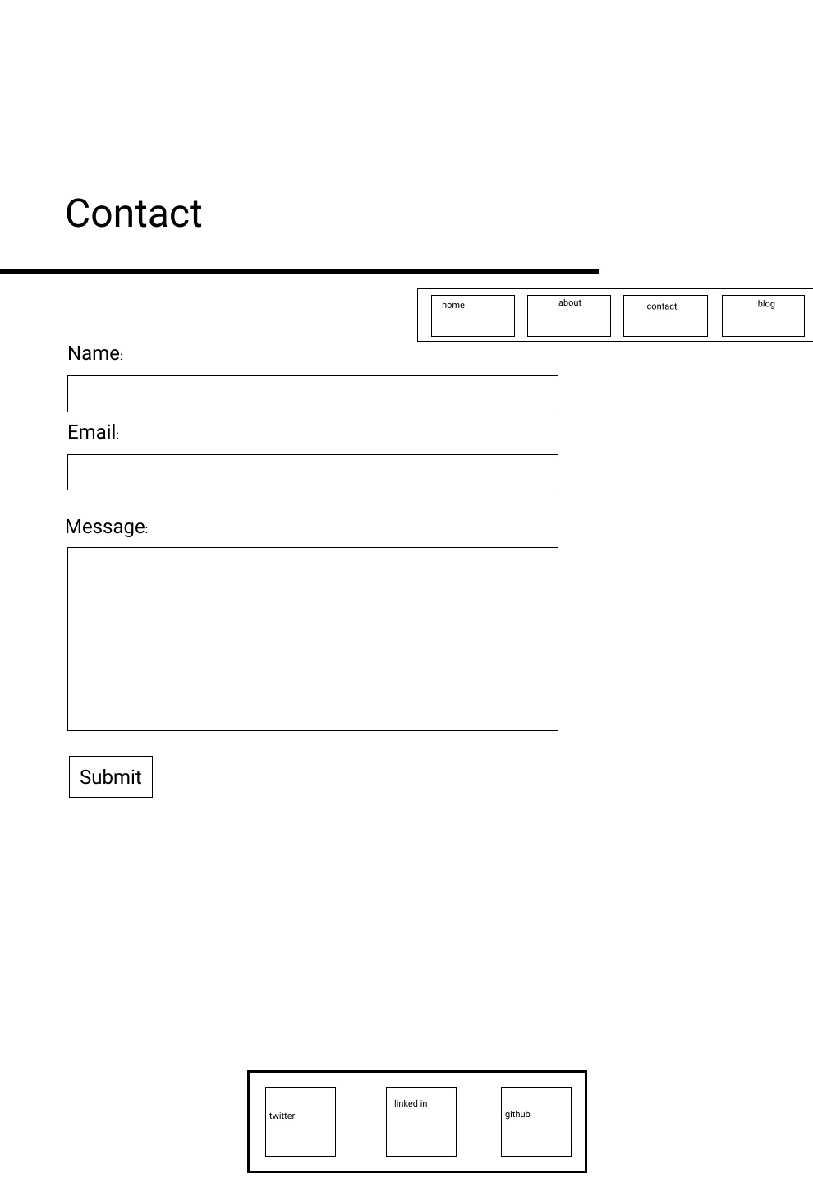
Tablet wireframes:

Slide 7
Tablet wireframes:

Slide 8
Tablet wireframes
Again:
Simple, repeated frame to keep pages cohesive
Square themes
Footer, titles and nav in same places for ease of navigation
Consistent up/down scrolling
Tablet specific:
Top nav bar for expected layout/navigation ease

Slide 9
Web wireframes:

Slide 10
Web wireframes:

Slide 11
Web wireframes
Again:
Simple, repeated frame to keep pages cohesive
Square themes
Footer, titles and nav in same places for ease of navigation
Top nav bar for expected layout/navigation ease
Consistent up/down scrolling
Web specific:
Drop-down list to jump to specific blog posts

Slide 12
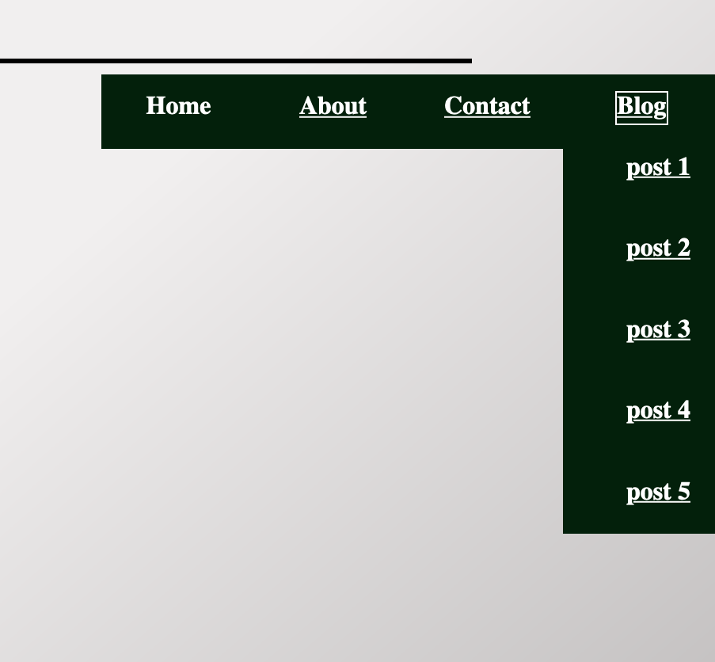
Components
Nav bar - positioning
Top nav used for web and tablet views for expected positioning, ease of navigation and to maximize space for content.
Drop down menu included on web to jump to specific blog posts.
Side nav included for ease of reach on mobile devices. Positioned approximately half way to minimize reach for different hand sizes.
Drop down excluded for screen space and function (hover feature works poorly on touch screen).

Slide 13
Components
Nav bar - links
Link removed when already on that page to improve accessibility of the site. This is to reduce output for screen readers/redundant options for scanning devices.

Slide 14

Components
Nav bar/footer - spacing
Nav bar and footer have been styled using flex and percentage dimensions to be reactive which allows:
for layout sizes/positions to be maintained
for items to be added or removed without affecting layout

Slide 15
Components
Animated bar
Added to demonstrate knowledge of keyframes without making the site too visually busy

Slide 16
Components
Alt tags on links
Added to improve accessibility of site and demonstrate knowledge of accessibility.
<a href="https://twitter.com/Adrienne_es?ref_src=twsrc%5Etfw" alt="twitter logo that links to my twitter profile">
<img src="src/images/twitterlogo.png" class="socials_images" alt="twitter logo that links to my twitter profile" />
</a>

Slide 17




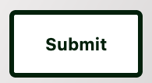

Components
Hover/active states on links
Added to improve engagement of site and demonstrate knowledge of conventions and appropriately modifying defaults.

Slide 18
Components
Dividing borders
Included on tablet/web versions to divide larger portions of blank space. Not included on web as blank space already minimized.
Styled using border of the blog post, rather than adding additional element e.g. <br>

Slide 19
Components
ID links
Each blog post has an ID tag which allows the user to jump to a post from the drop down list.

Slide 20
Challenges…

Slide 21
Challenges
Nav bar
I wanted to be able to toggle the nav bar for left handed users.
Notes:
But I couldn’t figure it out and meet other criteria with time given.

Slide 22
Challenges
position: fixed;
I had my site’s skeleton exactly how I wanted it, but nothing would scroll.
Notes:
Absolute to all parent classes, main div to position footer against.

Slide 23
Favourite part
Animated bar
Notes:
Second thing I implemented and I still love it.

